Slide 1

T O Y S A L E S A N A L Y S I S
GROUP MEMBERS:
Evans Ochieng’ Ojuok
Faith Njeri Mburu
Francis Mwangi Muthoni
Kellie Njoki Ndaru
Austin Alutsachi Murunga

Slide 2

Business Problem
Trends of toy sales over time
Performance of every product
Consumption of the products
Products with most revenue
And any other insights

Slide 3

DATA UNDERSTANDING
Salesdata (Excel format)
Main Data – has sales information (22 columns and 2823 rows)
Product Master – product description
Data Dictionary – descriptions of the main data and product master

Slide 4





Exploratory Data Analysis (EDA)
From our sales data , we can derive key insights and trends. Our main focus in our analysis are as follows
SALES ANALYSIS
PROFIT ANALYSIS
CUSTOMER ANALYSIS
ORDERS ANALYSIS

Slide 5

SALES ANALYSIS
In the sales analysis we will dig deeper into our sales trends and patterns.

Slide 6

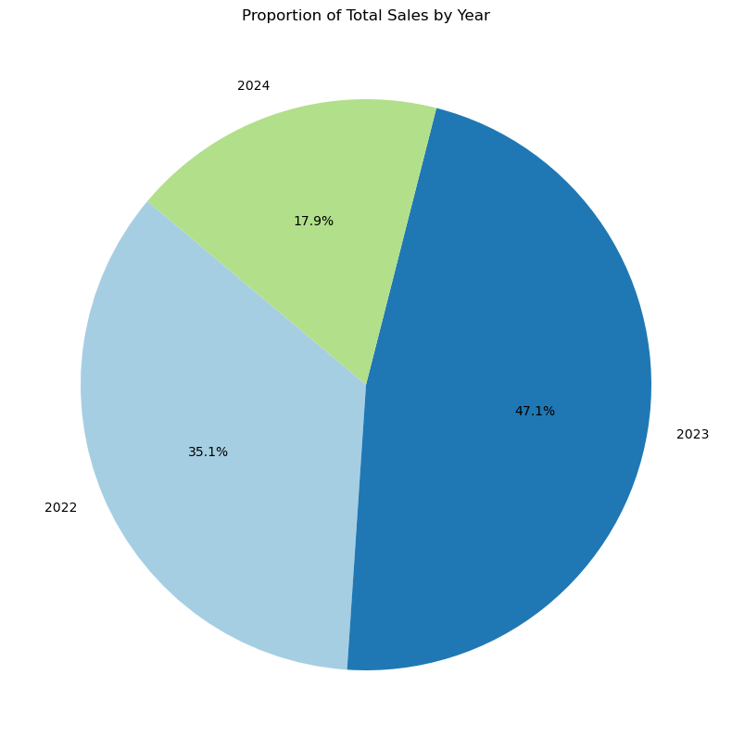

SALES OVER THE YEARS
Across the three years,the year 2023 had the highest sales of 47.1%.

Slide 7

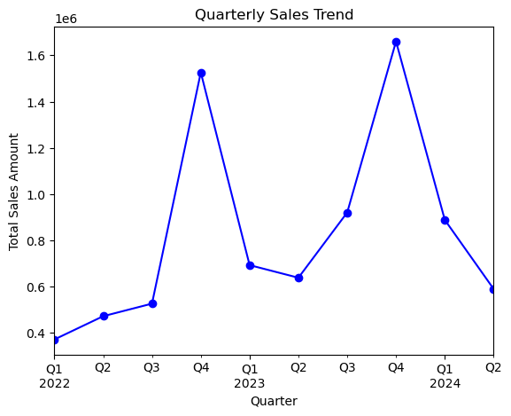

QUARTERLY SALES TRENDS
The quarterly sales trends show the trends in different quarters across the years.
From the line graph, the fourth quarter records the highest number of sales for the year 2022 and 2023

Slide 8

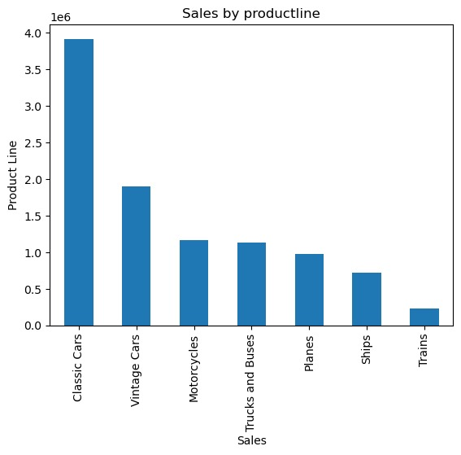
Sales of Every Product
With different toy products being sold, classic cars and vintage cars had the highest sales respectively.

Slide 9

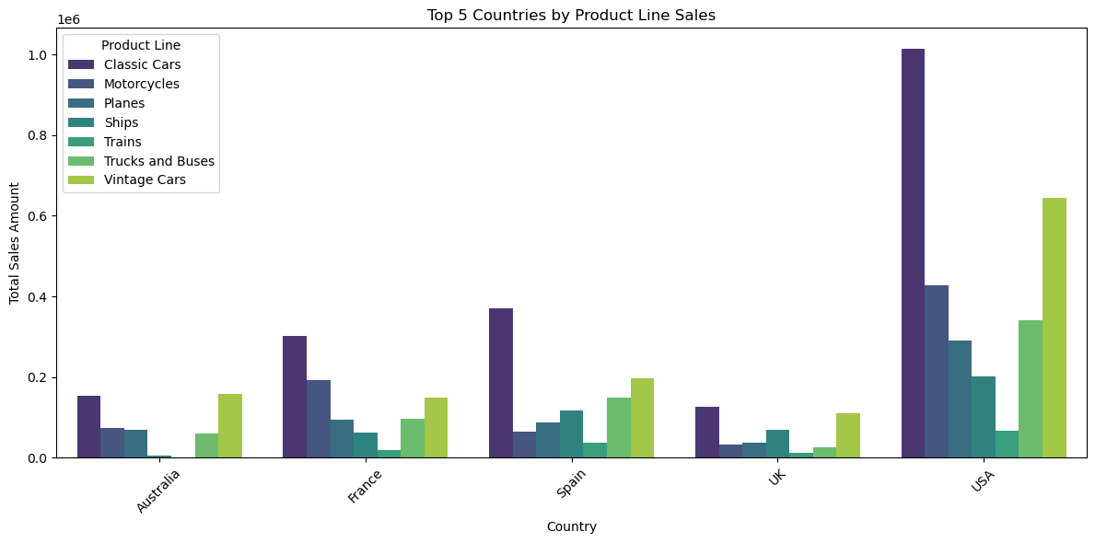

TOP COUNTRIES BY PRODUCT SALES
There is a common trend in every that cuts across all the countries in terms of product sales
Both classic cars and vintage cars respectively, have the highest sales in all countries

Slide 10
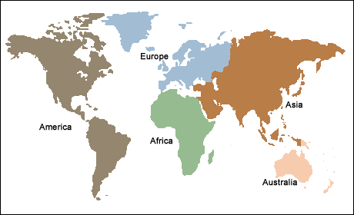
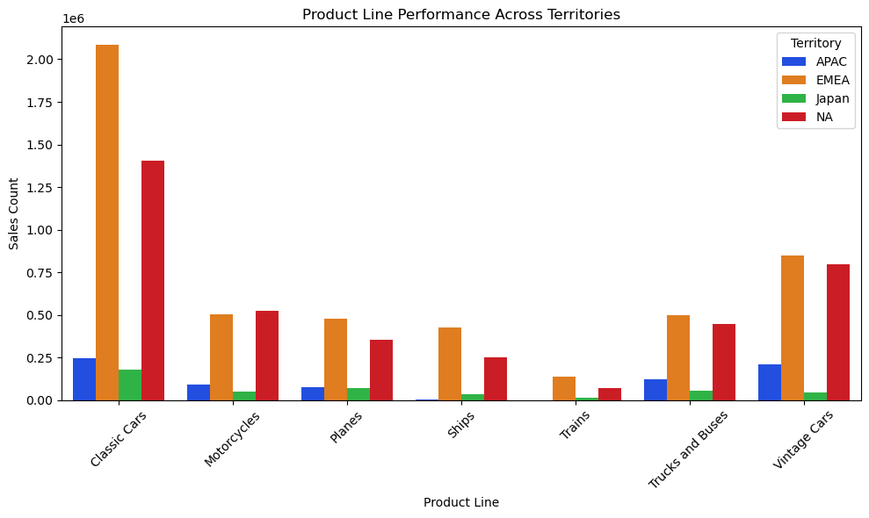
PRODUCT SALES ACROSS TERRITORIES
Europe Middle East Africa (EMEA) is the territory with the highest sales of all products
North America (NA) also recorded high sales, the second territory after EMEA.
The Common trend of classic cars and vintage cars having the highest sales is still evident and it cuts across all territories

Slide 11

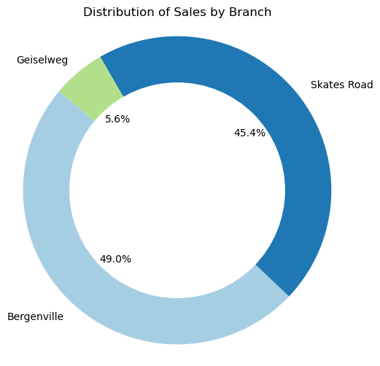
DISTRIBUTION OF SALES BY BRANCH
Bergenville is the branch with the highest sales of 49.0%
Skates Road branch also recorded high sales.This branch had 45.9%
Geiselweg branch had the lowest sales of 5.6%

Slide 12

ORDER ANALYSIS
In the order analysis , our key focus will be on the order status and the quarterly orderly trends.
By understanding these aspects, we can make informed decisions to improve order management, enhance customer satisfaction, and optimize sales strategies.

Slide 13

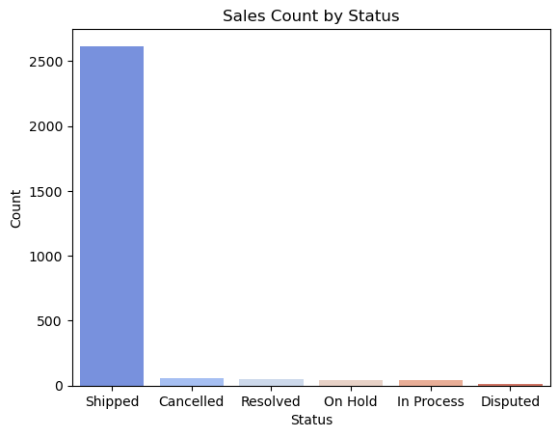

ORDER COUNT BY STATUS
The bar graph shows the shopping status count.
Most of the products were successfully shipped without any hindrance.

Slide 14

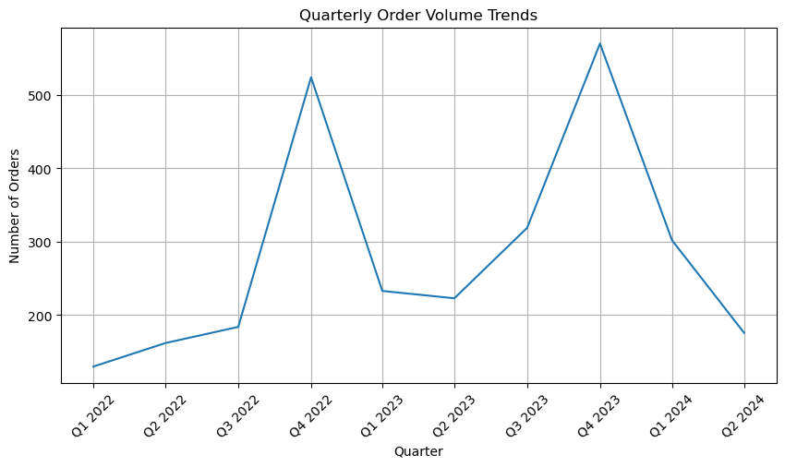
QUATERLY ORDER QUANTITY
The line graph shows the spike in order quantity in the fourth quarter
There is also growth in the number of orders quarterly across the years

Slide 15

PROFIT ANALYSIS
The goal of the profit analysis is to gain insights into the profitability of different product lines and identify the countries that contribute the most to the overall profit. This helps in making informed decisions to optimize product offerings and target key markets effectively.

Slide 16
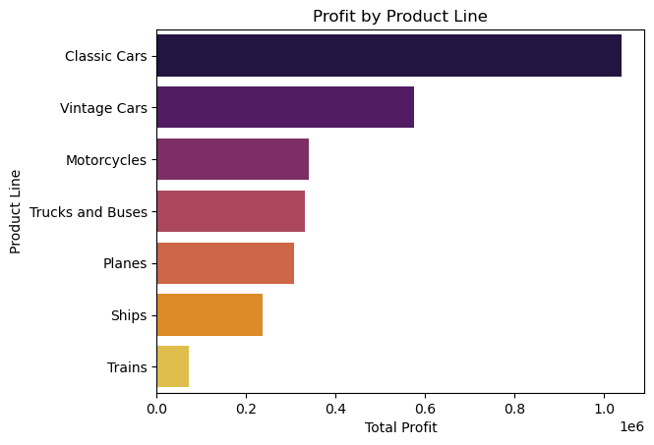
PROFIT BY PRODUCTLINE
From the graph , Classic cars and vintage cars are the products with the highest profit respectively

Slide 17
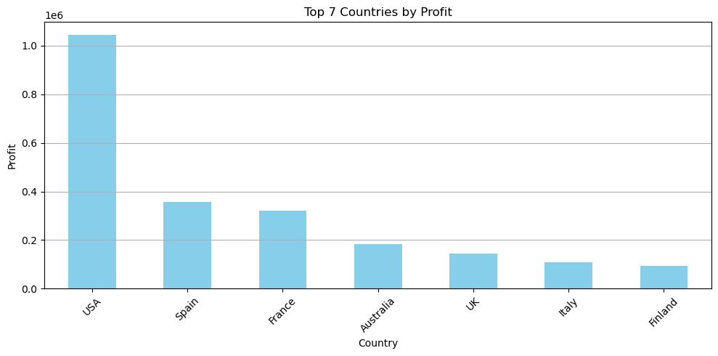
TOP COUNTRIES BY PROFIT
The graph clearly shows USA as the country that is leading in terms of profit returns.
Spain and France being the second and the third countries respectively

Slide 18

CUSTOMER ANALYSIS
The goal of the customer analysis is to gain insights into customer behavior, identify top repeat customers, and understand the geographical distribution of our customer base.
This helps in making informed decisions to enhance customer satisfaction, improve customer retention

Slide 19

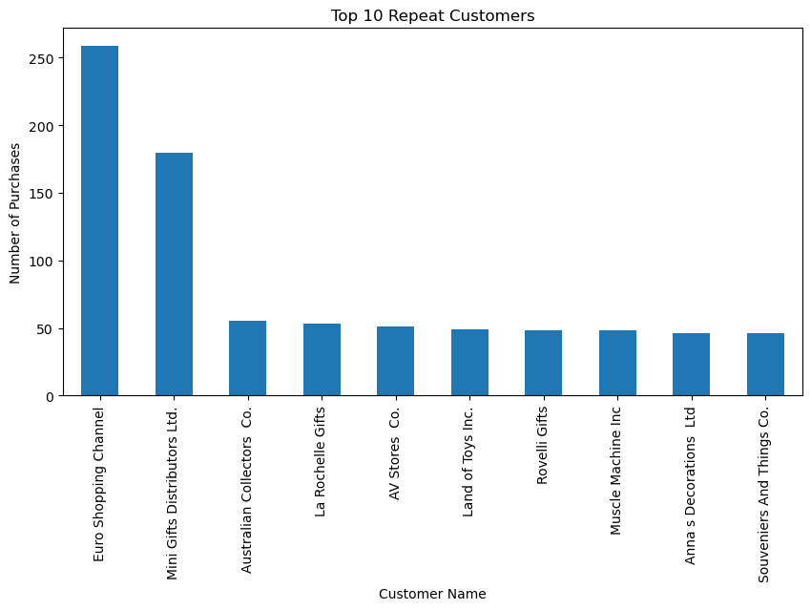
TOP 1O REPEAT CUSTOMERS
The graph evidently shows the top loyal customers.
Euro shipping Channel and Mini Gifts distributors ltd being the customers with the highest number of purchases
Our top two loyal customers having purchases more than 150

Slide 20
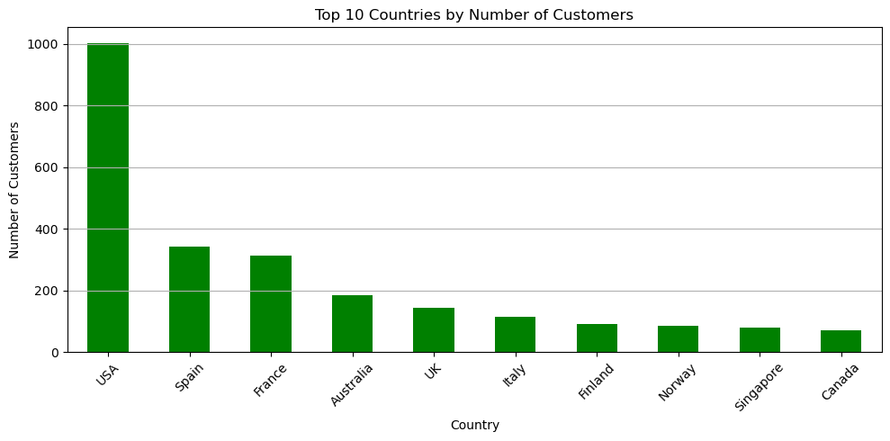
COUNTRIES WITH THE HIGHEST CUSTOMERS
The bar graph shows that most of our customers are from The United States of America (USA)
Spain and France being the countries with the highest number of customers in the Europe Middle East Africa (EMEA) Territory

Slide 21

THANK YOU
ANY QUESTIONS ?

